Slide 1

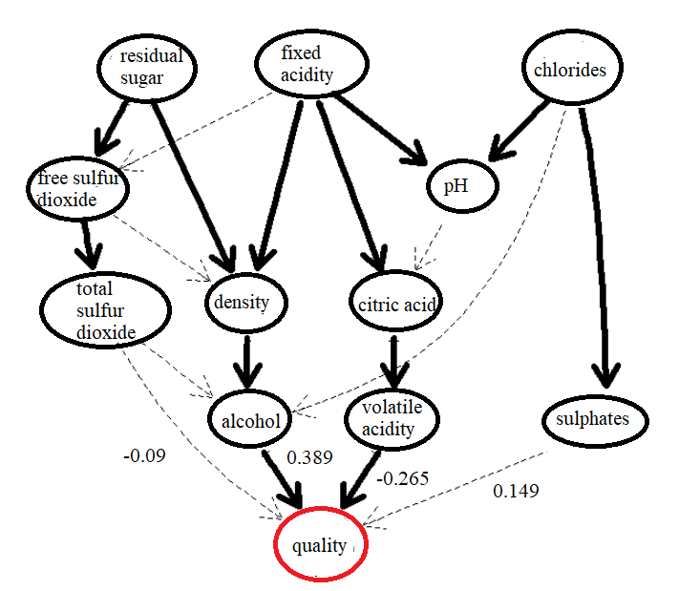
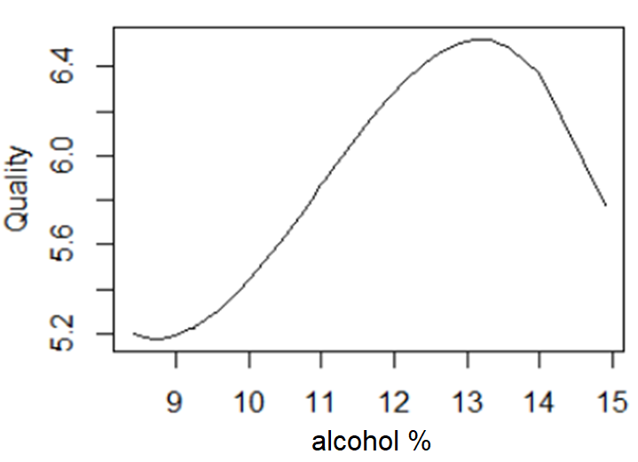
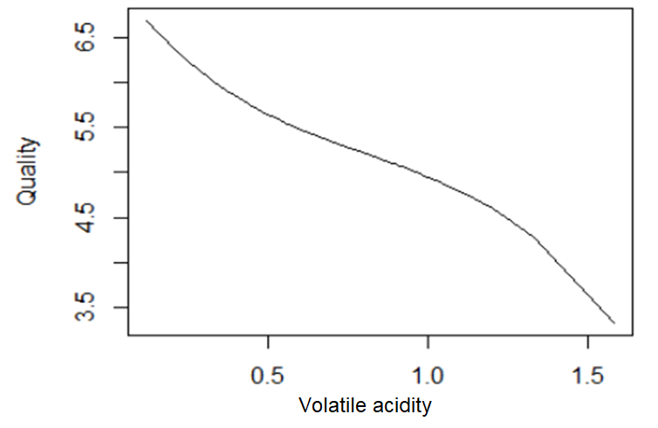
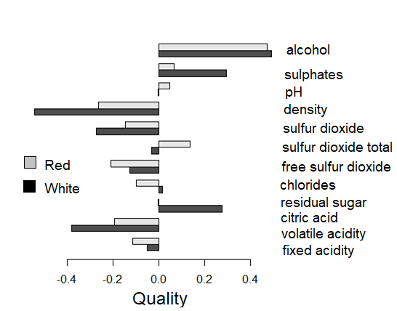
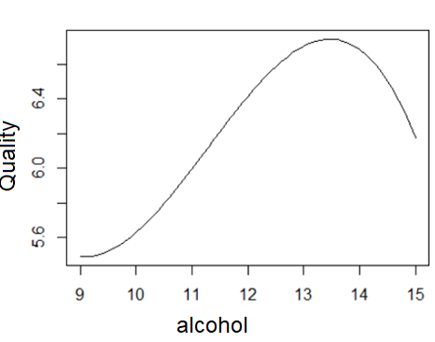
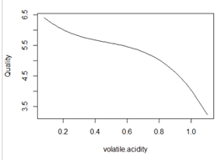

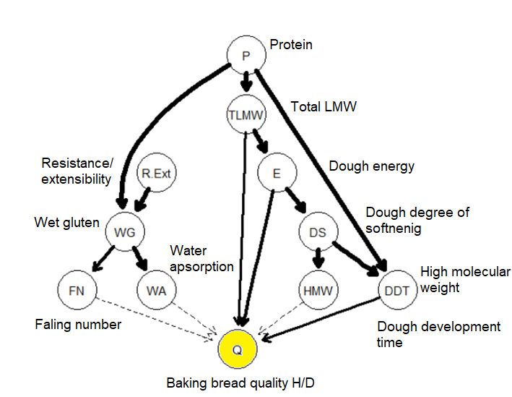
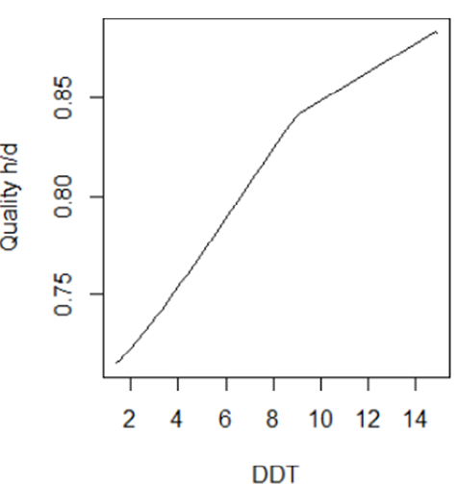
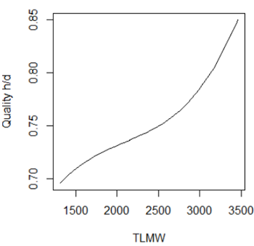
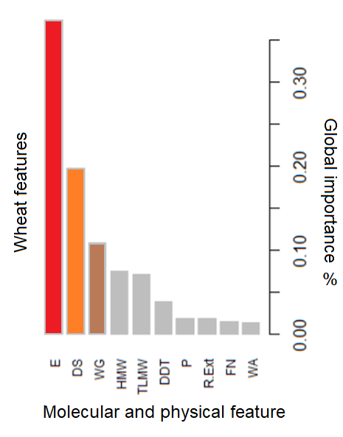
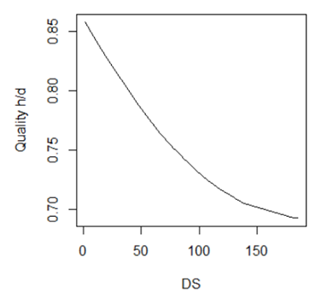
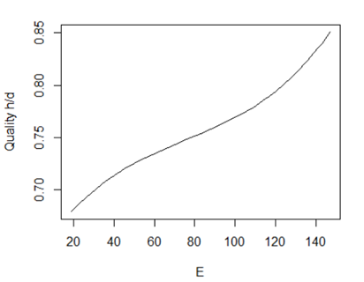
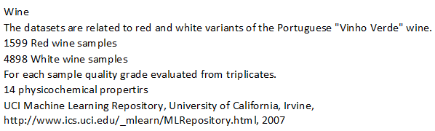
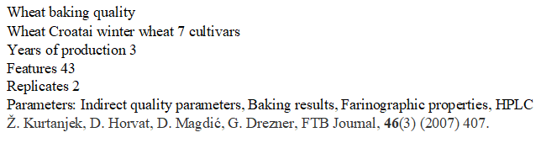
Statistical causal analysis of food quality
Želimir Kurtanjek
University of Zagreb, CROATIA
Applied is statistical evaluation of causal relations between food molecular analytics and food quality tests. Two sets of experimental data of wine and bread quality. The wine data set includes 7500 samples organoleptic wine preferences and 12 biochemical and physicochemical features. The bread data set includes 42 wheat samples and 45 chemical. physical and biochemical properties. indirect quality parameters (6), farinographic parameters (7), extensographic parameters (5), baking test parameters (2) and reversed phase-high performance liquid chromatography (RP-HPLC) of gluten proteins (25). Studied are causality effects of the wheat features and two technical baking quality parameters. The causal effects are evaluated from causal directed acyclic graphs (DAG) and application of Pearl d-separation algorithm to eliminate covariate confounding. The causal graphs are generated by deductive causalities by use of the field knowledge and inductive causalities evaluated statistical from observed experimental data. The causalities are estimated as point estimates by linear regression on population levels of the corresponding sample data sets. The linear estimates are compared to nonlinear causality effects by partial dependence plots of the corresponding boosted random forest decision models. Applied is open source DoWhy software available on GitHub. The causalities are discussed from view point of food quality monitoring, technology production monitoring and control, and potential genetic improvements of the cultivars.
Global impact of red and white wine analytics data
Red
Red
White
White
Fig. 1. DAG (Directed Acyclic Graph) causal network of red wine analytic data.
Fig. 2. Global importance factors for wine quality predictions.
Fig. 3. PDP (causal) impact of alcohol and volatile acidity of red and white wine quality.
SD = 8.4 %
SD =11.4 %
Fig. 4. DAG BN network of wheat analytical, physical properties and quality data.
Fig. 5. Global variable importance ifor prediction of baking quality.
Ffig. 6 PDP (causal) effect of molecular and physical properties on bread baking quality

